Slide 1


Methods
(Part 2)
Topic 7

Slide 2

Objectives
To Learn how to Pass Arguments to Methods
To Learn about Method that returns Value
To Learn about Method Overloading

Slide 3

Passing Arguments/Data to Methods
Sometimes, one or more pieces of data need to be sent to a method.
An actual parameter is any piece of data that is passed into a method when the method is called.
A formal parameter is a variable listed in the method’s header that receives the actual parameter that is passed into a method.
The actual and the formal parameter variable must be of the same/compatible data type.
Multiple parameters can be passed sequentially into a parameter list.

Slide 4
Passing Arguments/Data to Methods
In Java, data are passed by value.
‘Pass by Value’ means that only a copy of the actual data’s value is passed into the method through the formal parameter.
One-directional communication: called method cannot modify the value of the actual data.

Slide 5
Formal Parameter List
Syntax:
In method header:
Note: If more than 1 parameters, each parameter is separated with comma (,)
Eg.
public static void showMessage( String name )
public static void showMessage( String name, int num )
method name(dataType variableName, dataType variableName,....)
Notes:
Semasa panggilan method dilakukan, boleh ada lebih dari satu jenis data pada parameter.

Slide 6
Actual Parameter List
Syntax:
In method call:
Note: If more than 1 parameters, each parameter is separated with comma (,)
Eg.
showMessage( name )
showMessage( name, num )
method name(variableName, variableName,....)
showMessage( String name )
Notes:
Semasa panggilan method dilakukan, boleh ada lebih dari satu jenis data pada parameter.

Slide 7
Formal vs Actual Parameters
When a method is called, the actual parameters in the method call are copied into the formal parameters in the method header of the method definition.
Actual Parameters
showMessage("Ali",3);
Method call:
(Copy & pass the values to method)
Method definition:
(Should be the same data type)
public static void showMessage(String name, int num)
{
for (int i=1; i <= num; i++ )
System.out.println("Hello, " +name);
}
Formal Parameters
Output:
Hello Ali
Hello Ali
Hello Ali

Slide 8
Formal vs Actual Parameters
String name = “Aina”;
int num = 2;
showMessage(num, name)
Actual Parameters
Method call:
(Copy & pass the values to method)
Method definition:
public static void showMessage(int num, String name)
{
for (int i=1; i <= num; i++ )
System.out.println("Hello, " +name);
}
Formal Parameters
Output:
Hello Aina
Hello Aina

Slide 9
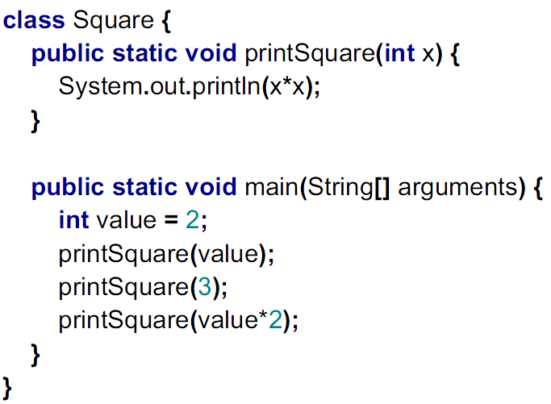
Exercise
What’s the output?
public

Slide 10
Exercise
What’s the output?
_{public}
Output:
4
9
16

Slide 11
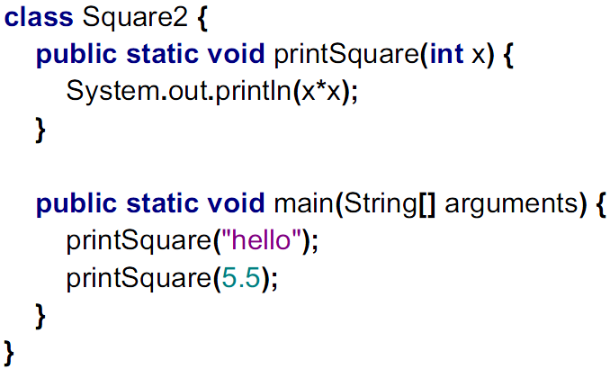
Exercise
What’s wrong here?
_{public}

Slide 12
Exercise
What’s wrong here?
_{public}
String
Type mismatched
double

Slide 13
Exercise
Create a class with a main() method and printInfo(name,matric,cgpa) method.
In the main method, user is prompted for name, matric and cgpa. Then, the method printInfo(name,matric,cgpa) is called and the three inputs are passed to the method.
In the printInfo(name,matric,cgpa) method, the name, matric number and cgpa of the user will be displayed.

Slide 14
Value-returning Method: return statement
On certain occasion, a method must return a value after finishing its task.
Returned value: The result that the method has computed and returns it to the caller.
If a method returns a value, it can only return exactly 1 value.

Slide 15
Value-returning Method: return statement
In the method body:
The body must contain a return statement at the end of method.
A return statement will result in execution flow to jump back to the caller & passes a value to the caller.
Syntax of return statement:
return expr;
Where expr can be Variable, Constant value or Expression

Slide 16
Value-returning Method: method header
The header must specify the type of the value returned (cannot use void).
The type in the method header must match with the type of the return statement.

Slide 17
Value-returning Method: Example
public static double calculateArea(double length, double width)
{
double area;
area = length * width;
return area;
}

Slide 18
Value-returning Method: Example
public static String determineAchievementLevel(int mark)
{
String achievementLevel;
if(mark >=75 && mark <=100)
achievementLevel = ’Good’;
else if(mark >=50 && mark <=74)
achievementLevel = ’Medium’;
else
achievementLevel = ’Low’;
return achievementLevel;
}

Slide 19
Value-returning Method: method call
In the method call:
when you call the method, the method will produce a value after it is executed.
Be sure to do something with the returned value such as assign the value to a variable, pass to another method etc.
Examples
double area= calculateArea(10,30);
double area= calculateArea(height,weight);
char grade = determineGrade(96);
char grade = determineGrade(mark);
System.out.println(createMessage());

Slide 20
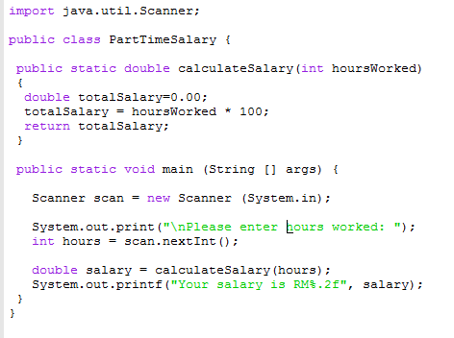
Value-returning Method: Examples

Slide 21
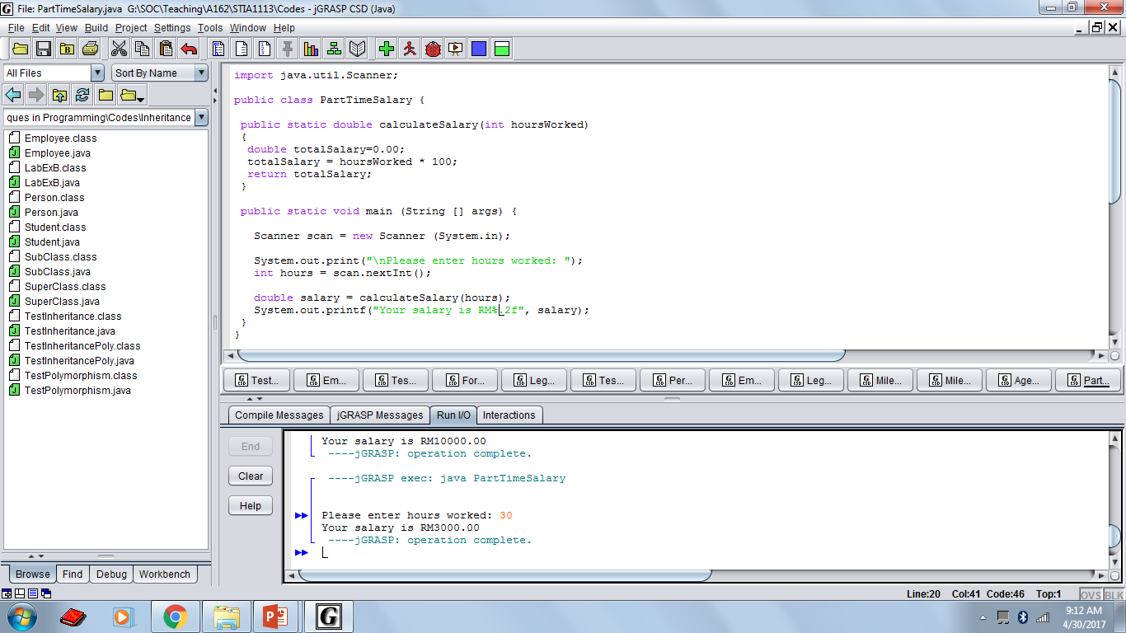
OUTPUT

Slide 22
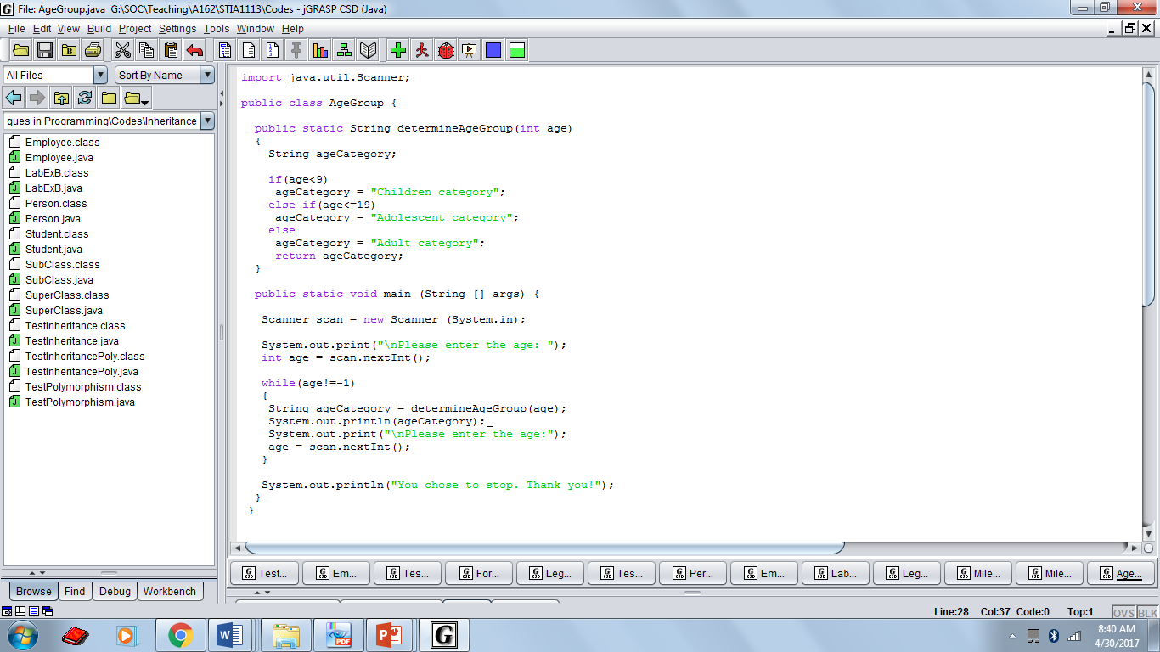

Slide 23
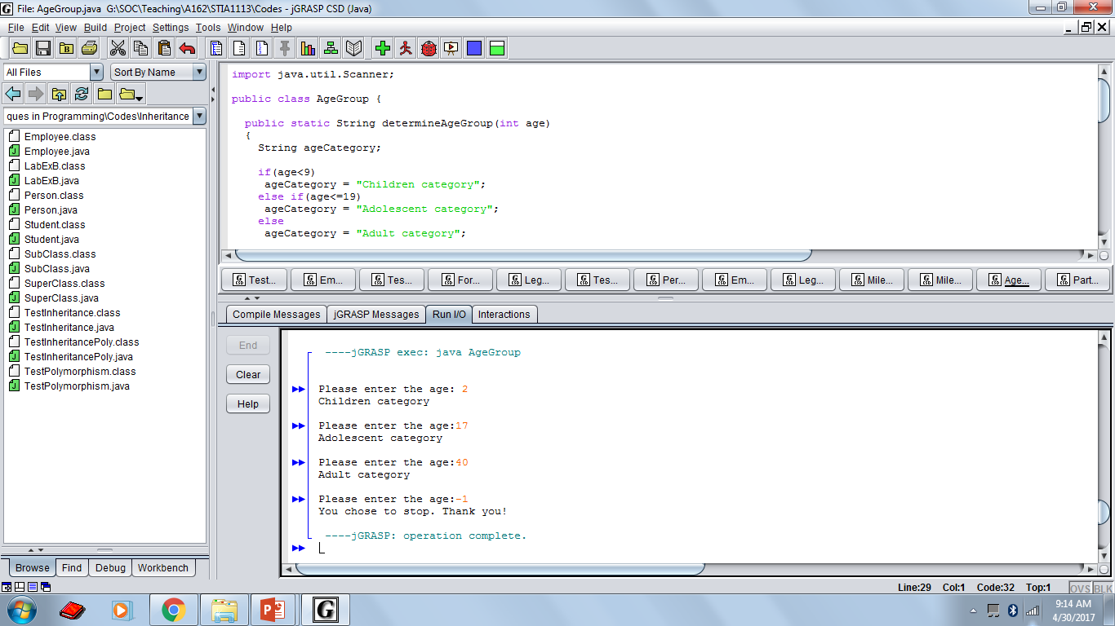
OUTPUT

Slide 24
Exercise
Write the method header and method call for each of the following methods:
Method hypotenuse that takes two floating-point arguments, side1 and side2, and returns a floating-point result.
Method smallest that takes three integers, x, y, z, and returns an integer.
Method instructions that does not receive any arguments and does not return a value.
Method intToFloat that takes an integer argument, number, and returns a floating point result.

Slide 25
Exercise
Change this code into 3 methods: main(), calculateVolume(radius, PI) and calculateArea(radius,PI)
Hint: In the main() method, the variable radius and constant PI is declared and initiated. Then, the main() method calls value returning methods which are calculateVolume(radius,PI) and calculateArea(radius, PI). At the end, the volume and area of the sphere is displayed in the main method.
public class Sphere { public static void main (String [ ] args) { int radius =7; final double PI = 3.142; System.out.println("Lets calculate the volume and area of sphere"); double volume = 4.0/3.0*PI* Math.pow(radius,3); double area = 4.0*PI*radius*radius; System.out.printf("The volume for sphere is %5.2f%n", volume); System.out.printf("The area for sphere is %5.2f%n",area); } }

Slide 26
Method Overloading
Within a class, we can define more than one method with the same name but different parameter signature. We call this method overloading.
Parameter signature is the number and types of the parameters.
Two methods are said to have different parameter signature:
If both methods have a different number of formal parameters.
If the number of formal parameters is the same, the type of the formal parameters must differ.

Slide 27
Method Overloading
Different parameter signatures example:
(method body not shown)
public static void methodABC()
public static void methodABC(int x)
public static void methodABC(double x)
public static void methodABC(int x, double y)
public static void methodABC(double x, int y)
public static void methodABC(char x, double y)
public static void methodABC(String x,int y)

Slide 28
public class Exam { public static void main (String [] args) { double test1=75, test2=68, total_test1, total_test2; System.out.println("Exam results"); total_test1 = result(test1); System.out.println("Total test 1 : "+ total_test1); total_test2 = result(test1,test2); System.out.println("Total test 2 : "+ total_test2); } public static double result (double i) { double bonusMark = i + 5; return bonusMark; } public static double result (double i, double j) { double finalMark = 20.0 / 100 * (i + j) ; return finalMark; } }

